Slide 1
C. D. BROAD’S “THE ARGUMENT FROM RELIGIOUS EXPERIENCE”

Slide 2
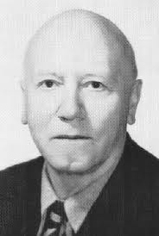
CHARLIE DUNBAR BROAD

Slide 3
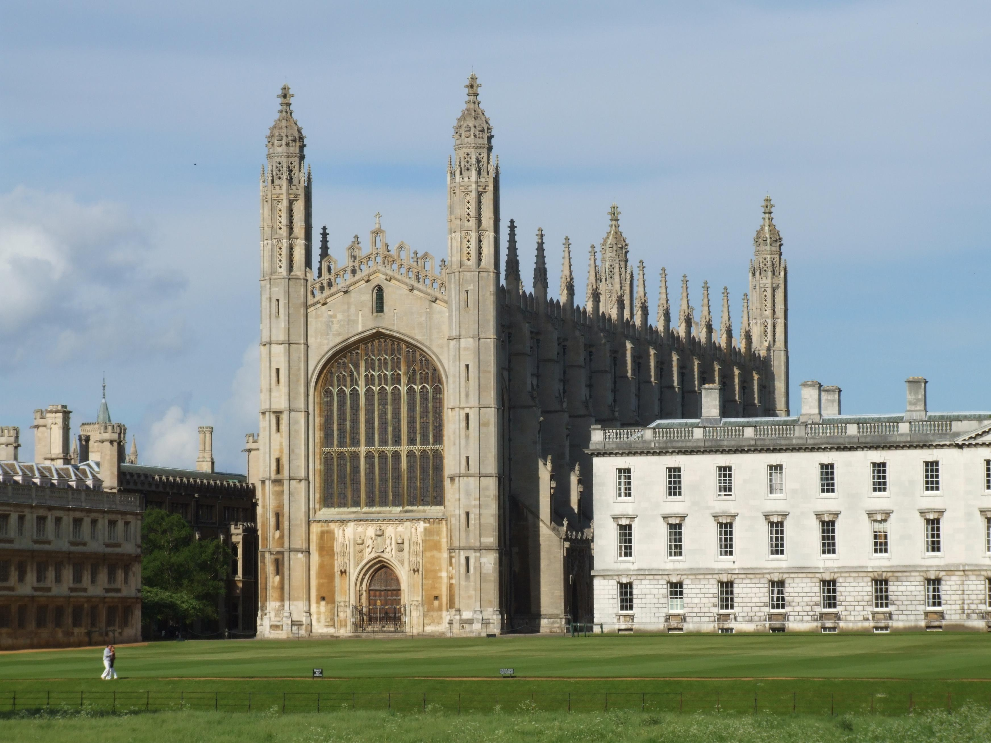

Slide 4
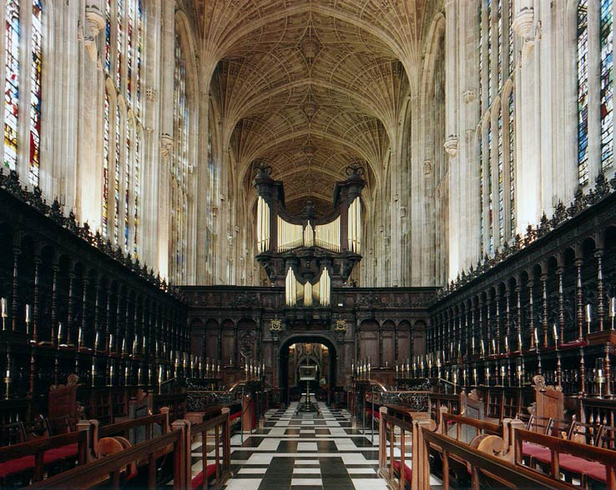

Slide 5
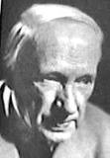
G. E. MOORE

Slide 6
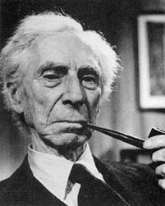
BERTRAND RUSSELL

Slide 7
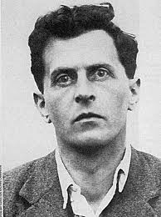
LUDWIG WITTGENSTEIN

Slide 8
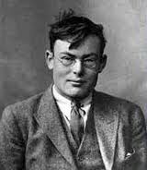
FRANK P. RAMSEY

Slide 9
ARGUMENTS FROM DESIGN AND ARGUMENTS FROM ETHICAL PREMISES
Broad defers to the criticisms of Immanuel Kant and David Hume of the Argument from Design. He knows of no effective rebuttal of their criticisms – therefore he (Broad) will not discuss the first of these.
On the second, he has responded elsewhere.

Slide 10
ANALOGY BETWEEN EAR FOR MUSIC AND SUSCEPTIBILITY TO MYSTICAL EXPERIENCE
There are a number of significant analogies between various ways of studying the one and the other (p. 76), but the important disanalogy is that mystical experiencers claim to come to know that something is true or probable as a result of their experience.

Slide 11
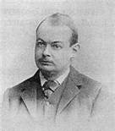
JOHN McTAGGART ELLIS McTAGGART

Slide 12
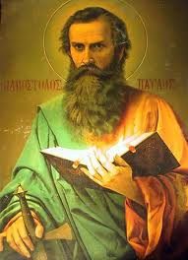
ST. PAUL

Slide 13
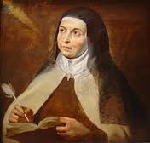
ST. TERESA OF AVILA

Slide 14
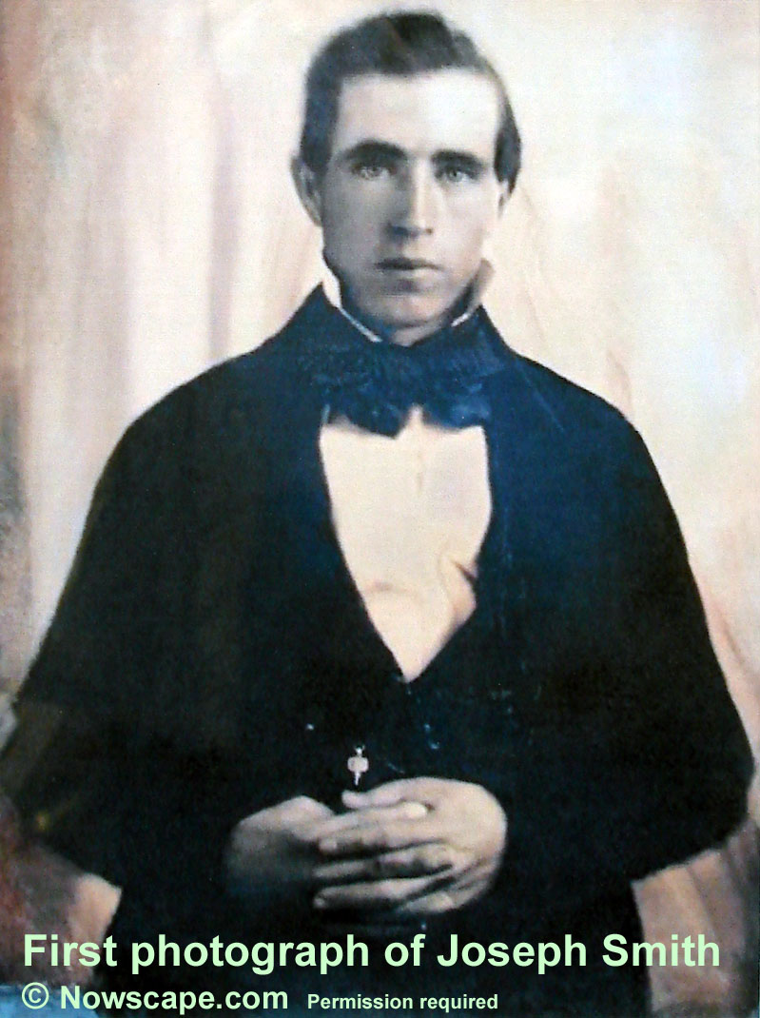
JOSEPH SMITH

Slide 15

ZEN BHUDDIST

Slide 16
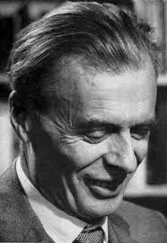
ALDOUS HUXLEY

Slide 17
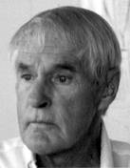
TIMOTHY LEARY

Slide 18
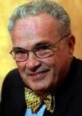
CARLOS CASTANEDA

